Slide 1

Queen Elizabeth ii
Platinum Jubilee 2022
Notes:
Who is Queen Elizabeth ll ? Is she important? What is a platinum jubilee?

Slide 2
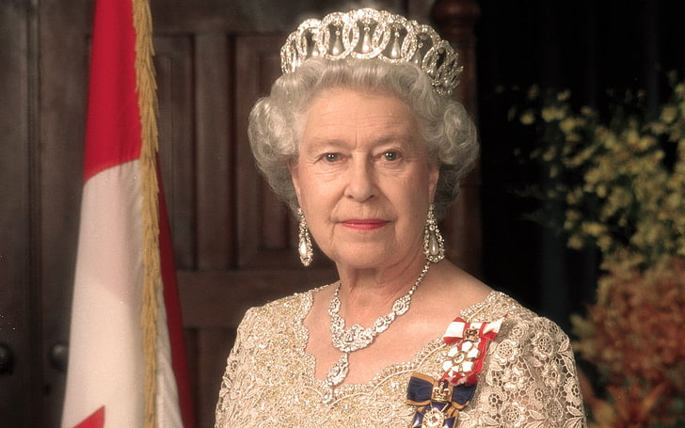
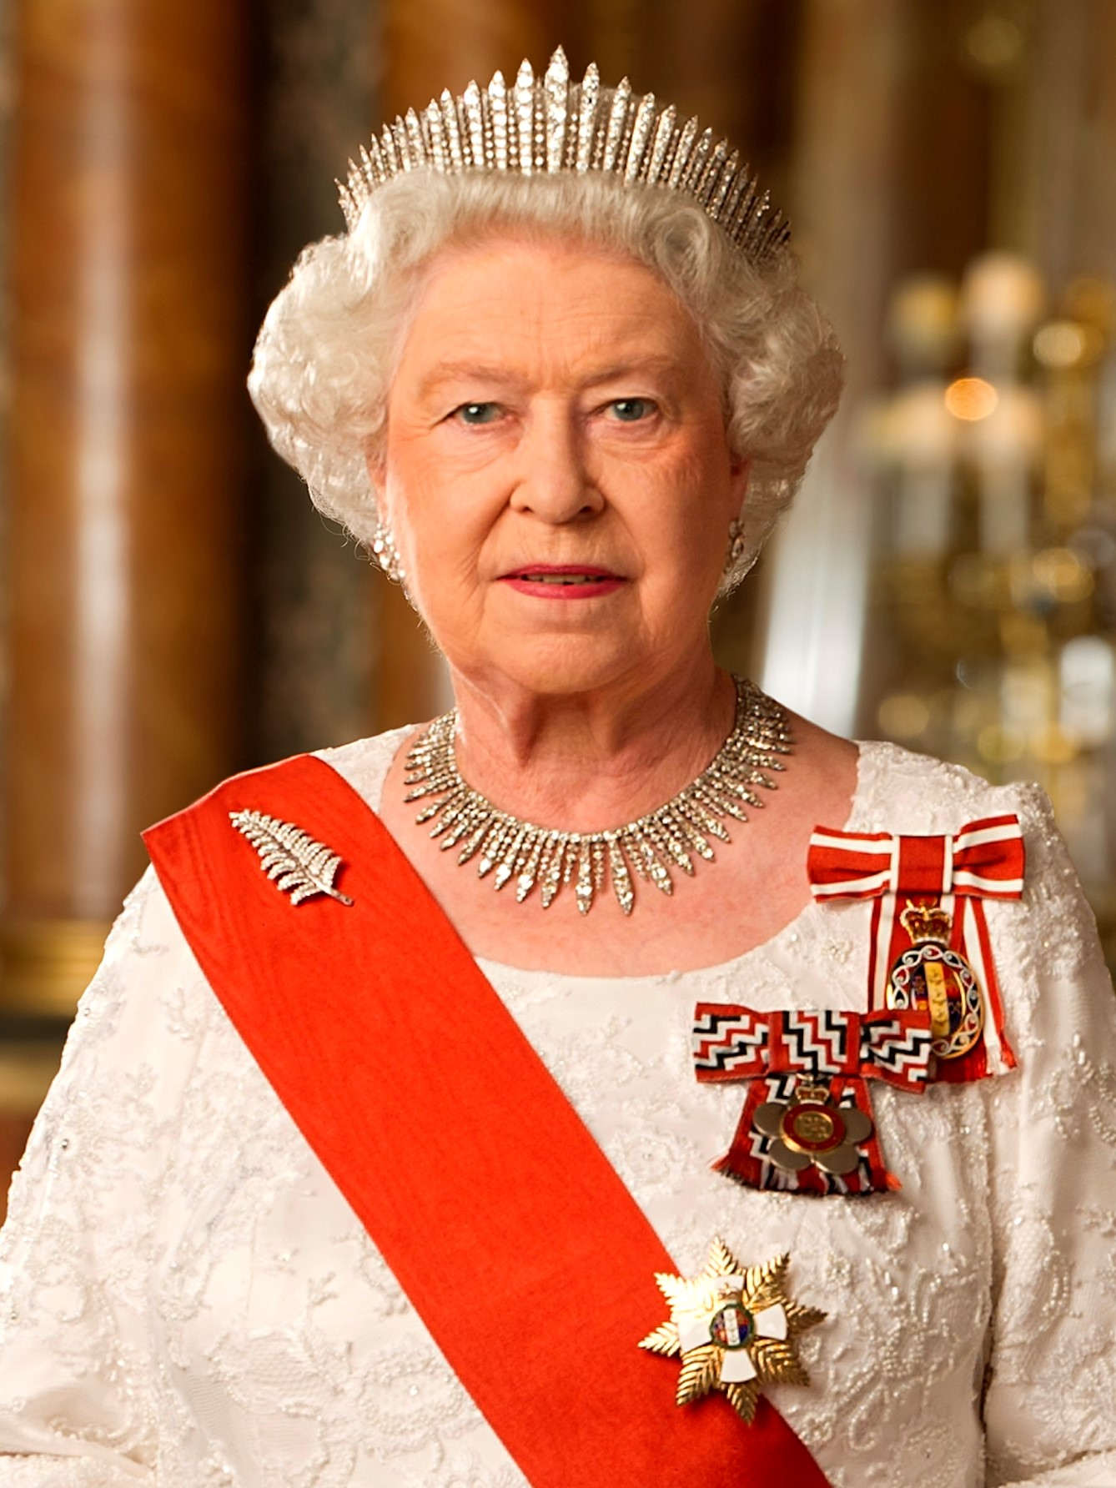
This Photo by Unknown Author is licensed under CC BY-SA
Notes:
Is she the queen of Canada? What other countries recognize Queen Elizabeth II as their head of state? Where does she live?

Slide 3
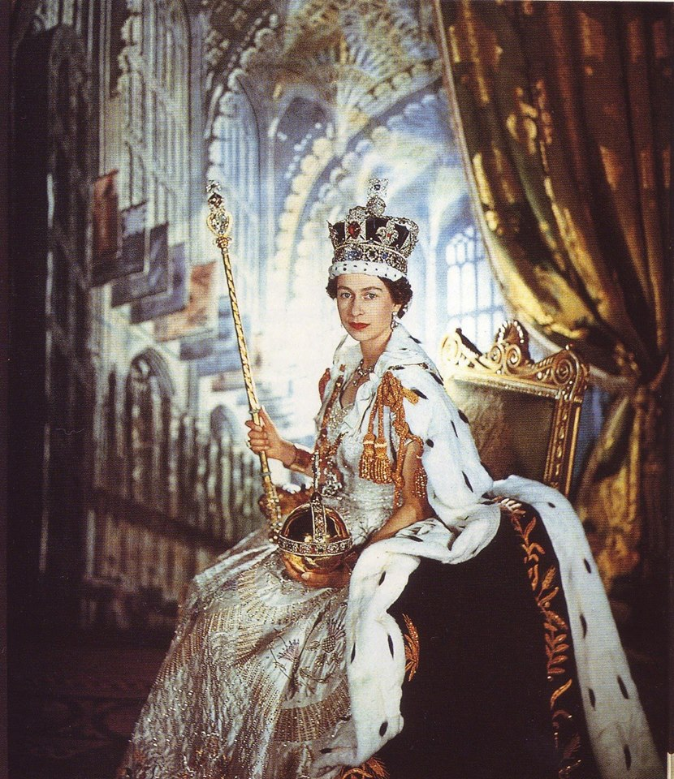
The Queen’s Coronation 1953
Notes:
What is a coronation? How old do you think Elizabeth was when she became the Queen? Why did she become queen in 1953?
What is a coronation? Why was Queen Elizabeth coronated in 1953? How old do you think she was?

Slide 4
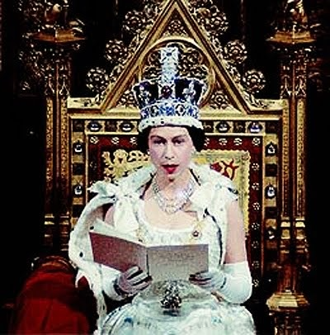
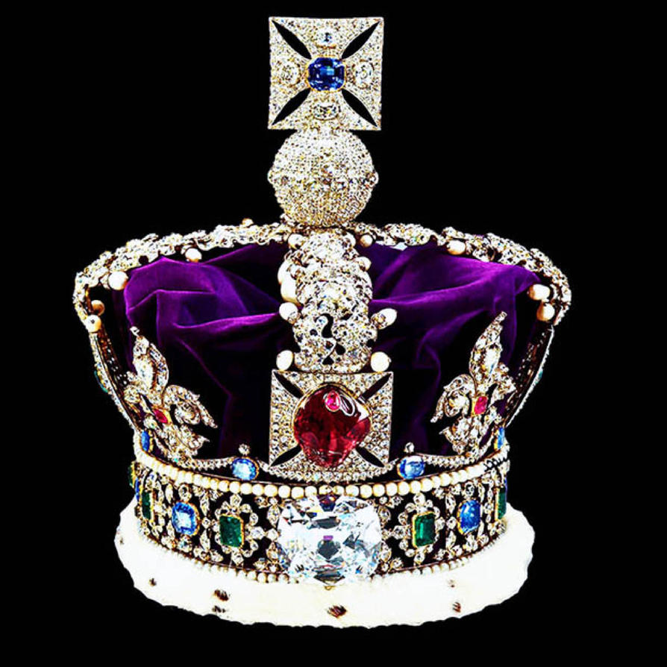
The coronation crown
Notes:
What does the crown symbolize?

Slide 5
Role of the Queen
ceremonial: opening Parliament, meeting important visitors to the United Kingdom & making official visits to other countries
signs government documents, but does not state her opinion about events, or argue with elected officials
her son and grandson and their wives make foreign visits because of the Queen’s age (95)
members of the royal family host parties, give out awards, and attend many functions in the UK & Commonwealth countries
they undertake over 2000 official engagements yearly
Notes:
What is the United Kingdom? Would the Prime Minister of Canada meet with the Queen when he is in London for meetings? Is it surprising the Queen is still working at 95?

Slide 6
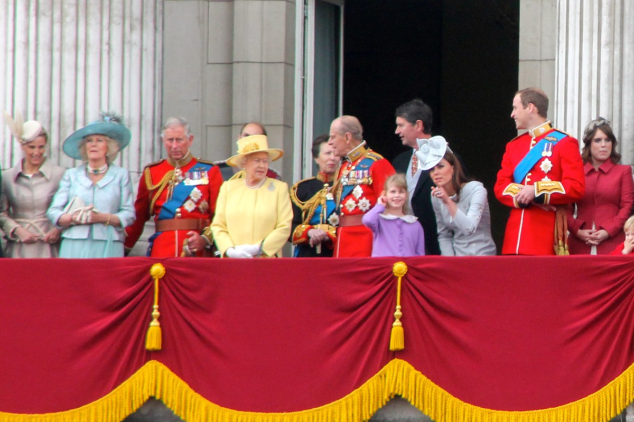
The Queen’s family
Notes:
How many children does the Queen have, how many grandchildren and great grandchildren?

Slide 7
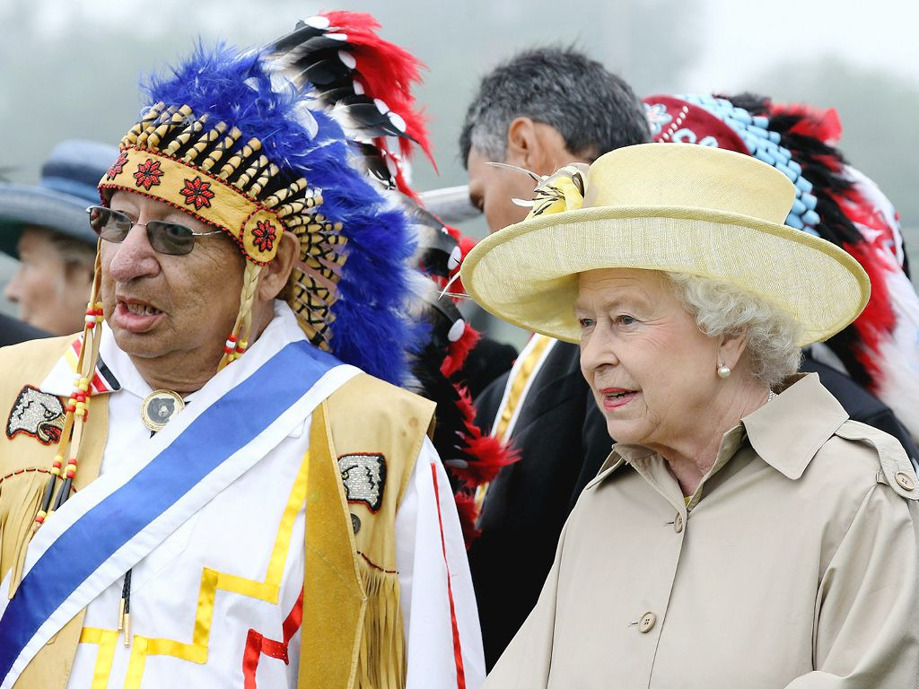

The Queen in Canada
This Photo by Unknown Author is licensed under CC BY-NC
Notes:
How has Canada recognized the Queen? Think of where you see her image everyday?

Slide 8
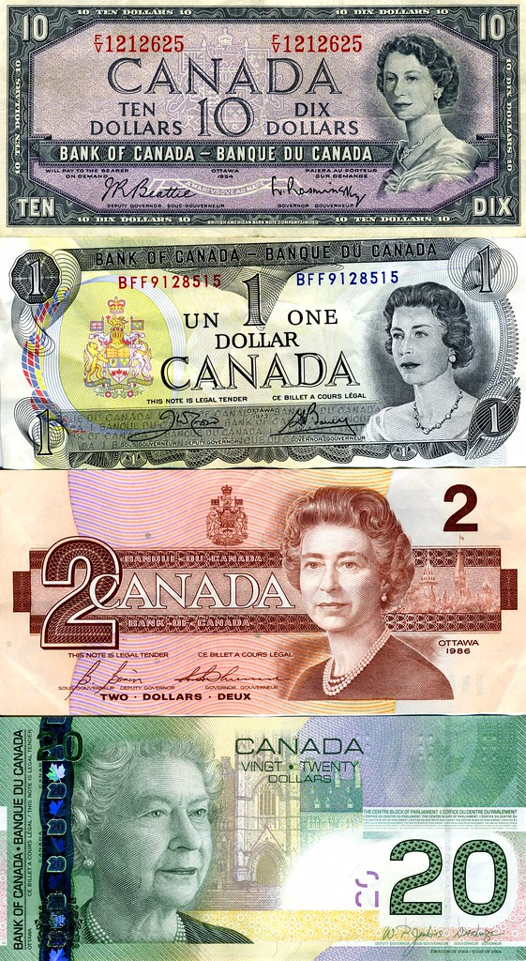
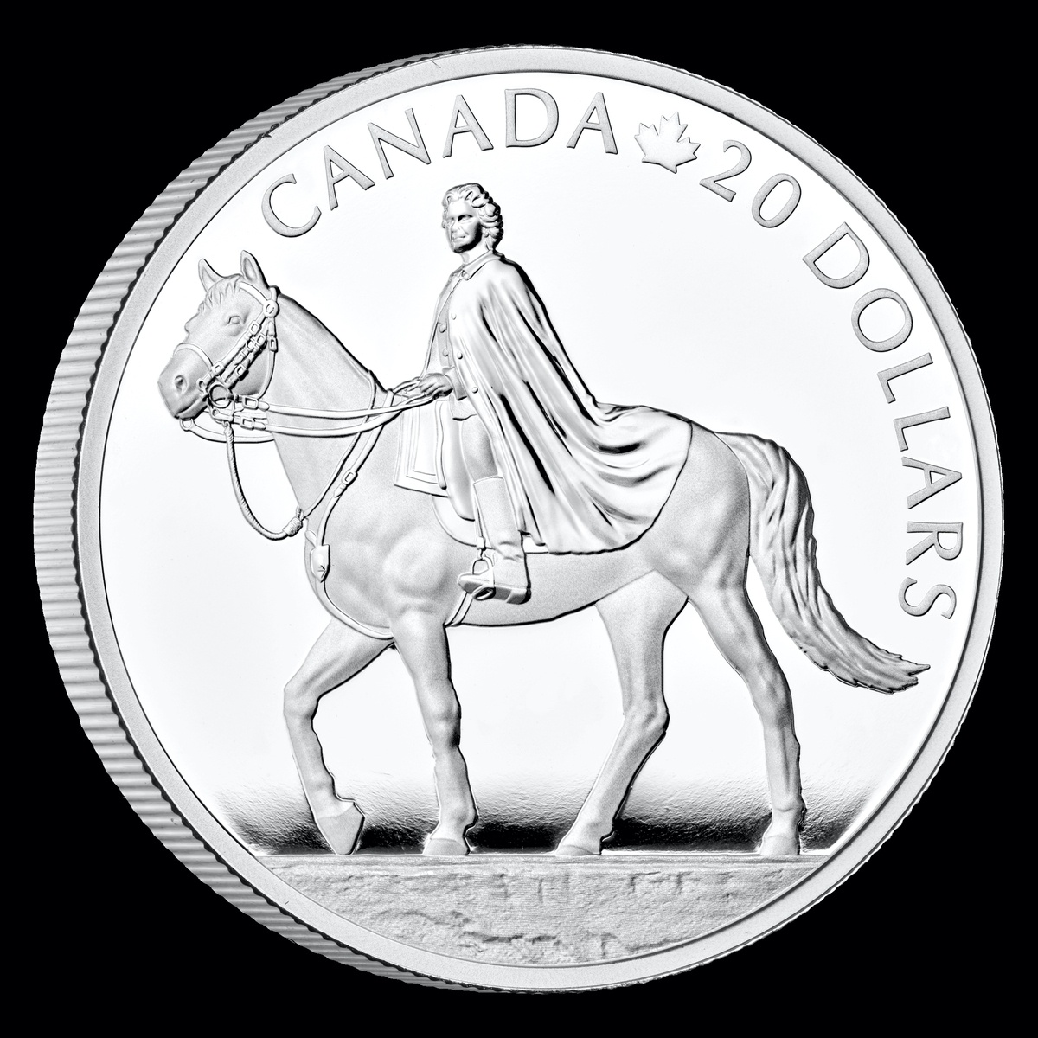
Queen ELIZABETH II COINS & BILLS
This Photo by Unknown Author is licensed under CC BY-SA-NC
This Photo by Unknown Author is licensed under CC BY-NC

Slide 9
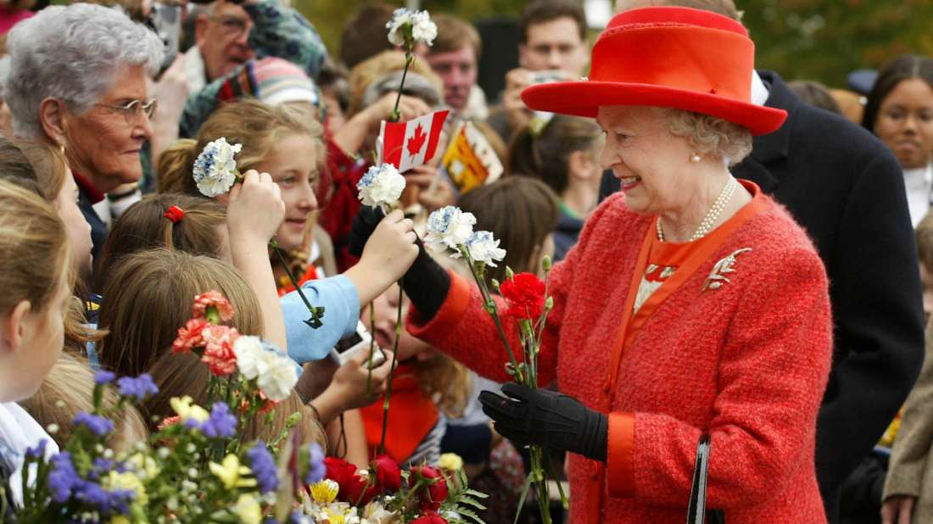
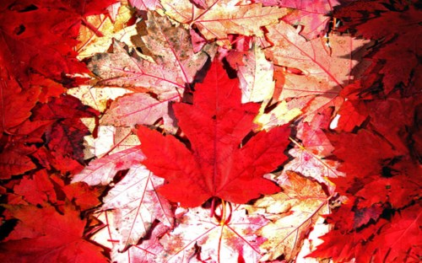
This Photo by Unknown Author is licensed under CC BY-SA
Notes:
Why do people give the Queen flowers when she visits? Why do you think she is wearing red? Can you think of places in British Columbia named in honour of the Queen?

Slide 10
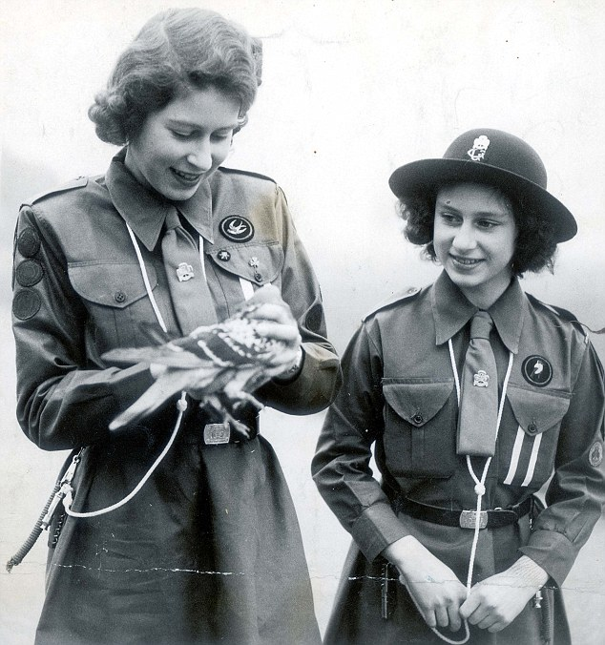
Princess Elizabeth and her sister Margaret in Girl Guides
Notes:
Why do you think Brownies, Guides and Scouts meet the Queen? Think of their motto. Would you like to meet her? Why?

Slide 11
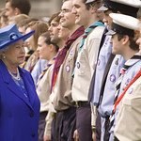
Queen meeting Scouts

Slide 12
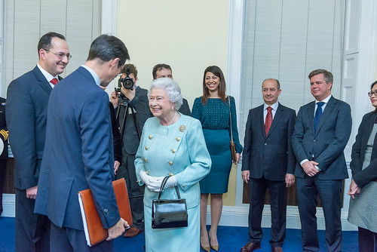
Queen meeting
world leaders
This Photo by Unknown Author is licensed under CC BY
Notes:
Why do world leaders want to meet with the Queen?

Slide 13
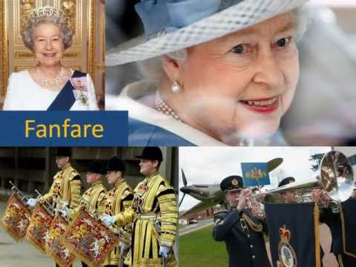
Notes:
What is a fanfare and why does the Queen deserve one? How will you remember the Queen this year as she celebrates 70 years as our Queen?

